Slide 1
Section 2.1 Rates of Change and
Tangents to Curves
In this section we introduce the ideas of average and instantaneous rates of change, and show that they are closely related to the slope of a curve at a point P on the curve. We give precise developments of these important concepts in the next chapter, but for now we use an informal approach so you will see how they lead naturally to the main idea of the chapter, the limit.

Slide 2
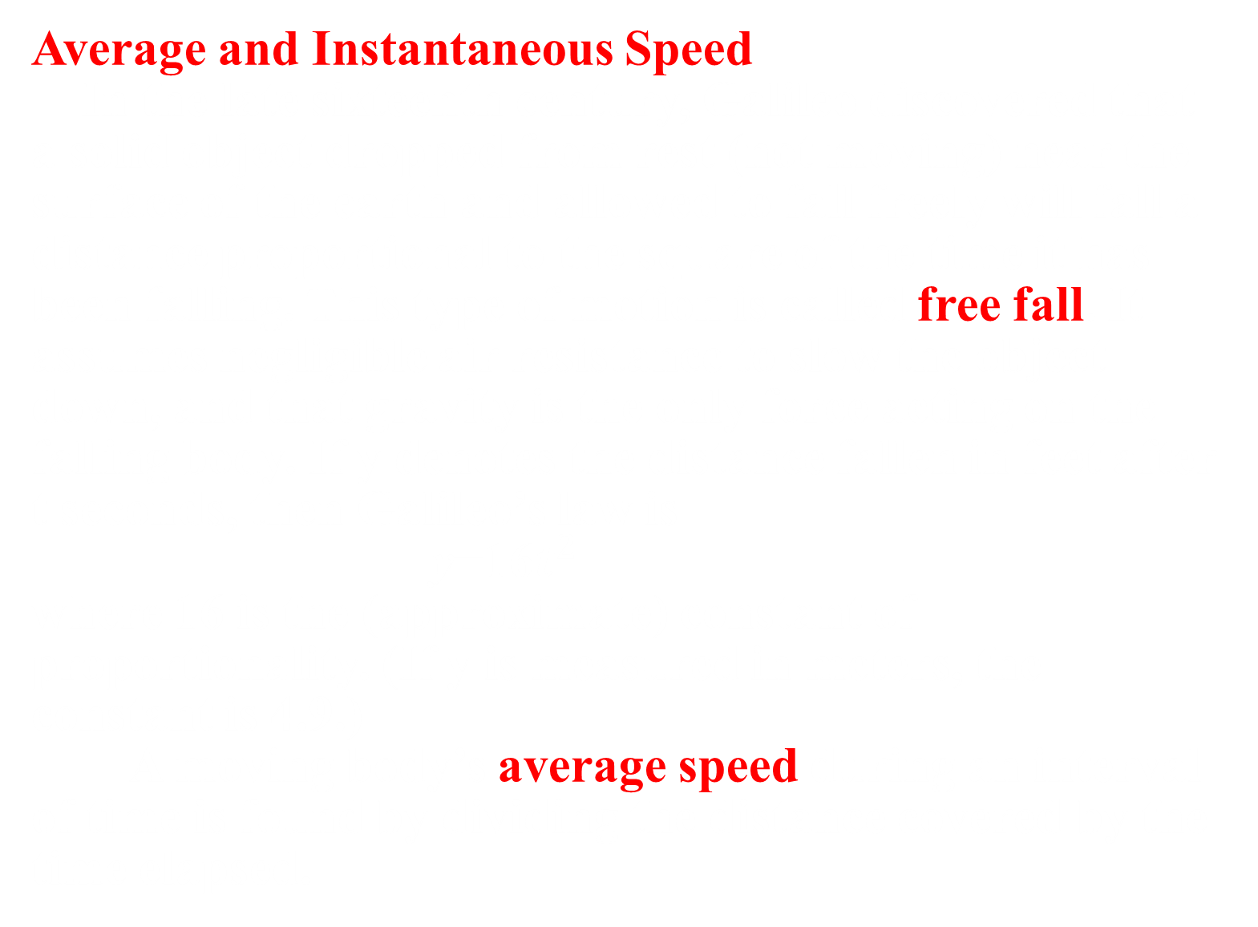

Slide 3
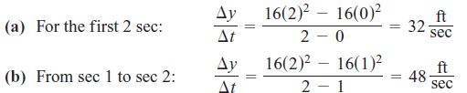
EXAMPLE 1 A rock breaks loose from the top of a tall cliff. What is its average speed
(a) during the first 2 sec of fall?
(b) during the 1-sec interval between second 1 and second 2?
Solution

Slide 4
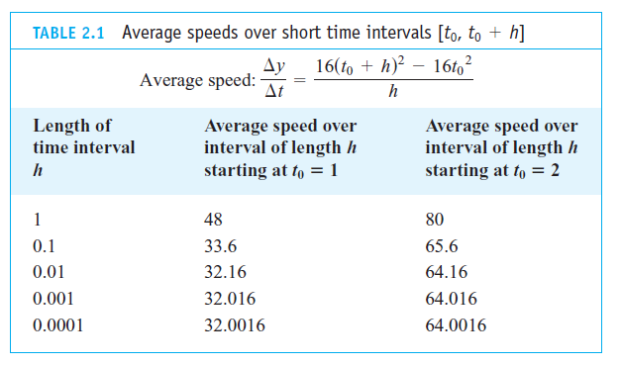

EXAMPLE 2 Find the speed of the falling rock in Example 1 at t=1 and t=2 sec.
Solution:

Slide 5

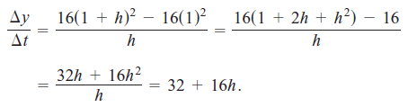
For values of h different from 0, the expressions on the right and left are equivalent and the average speed is 32+16h ft/sec. We can now see why the average speed has the limiting value 32+16(0)=32ft/sec as h approaches 0.

Slide 6
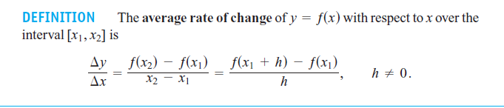
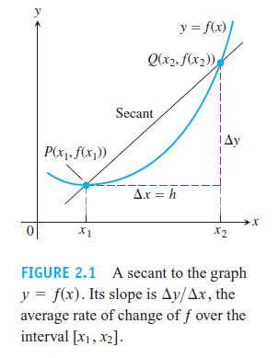
Average Rates of Change and Secant Lines
In geometry, a line joining two points of a curve is a secant to the curve.

Slide 7
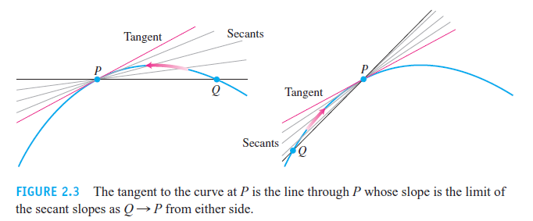
To define tangency for general curves, we need an approach that takes into account the behavior of the secants through P and nearby points Q as Q moves toward P along the
curve (Figure 2.3). Here is the idea:
1. Start with what we can calculate, namely the slope of the secant PQ.
2. Investigate the limiting value of the secant slope as Q approaches P along the curve.(We clarify the limit idea in the next section.)
3. If the limit exists, take it to be the slope of the curve at P and define the tangent to the curve at P to be the line through P with this slope.

Slide 8

